Slide 1
Falck Medical Multi-Function DEVICE
COPYRIGHT 2020

Slide 2
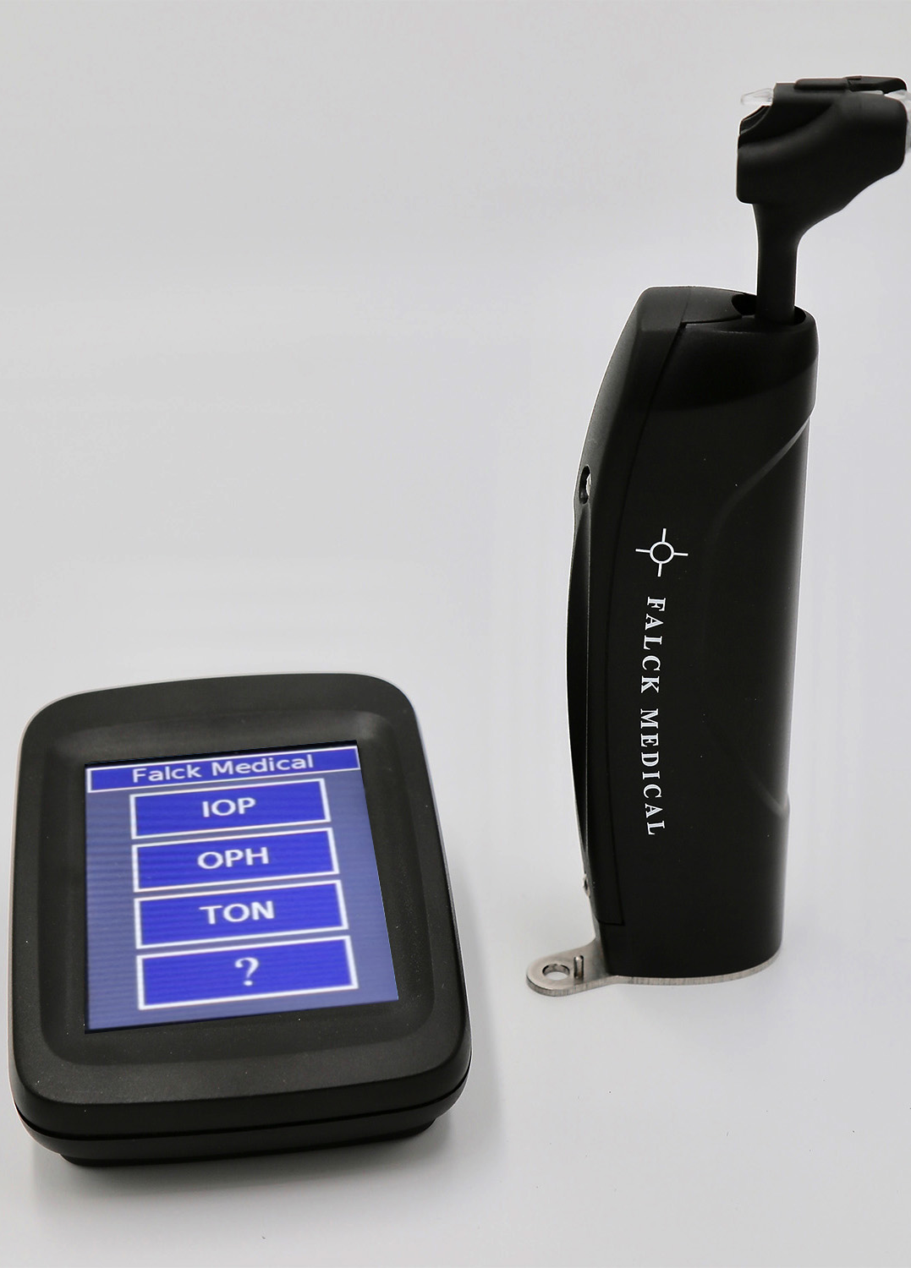
FAT1 Device
First Artificially Intelligent FDA PMA Cleared Combination Device:
Serial Intra-Ocular Pressure.
Ophthalmodynamometry.
Tonography.
Fixed Use Disposable Prism. Blocks Infection.
Multiple FDA PMA Clinical Efficacy Studies.
Multiple National / International Patents

Slide 3
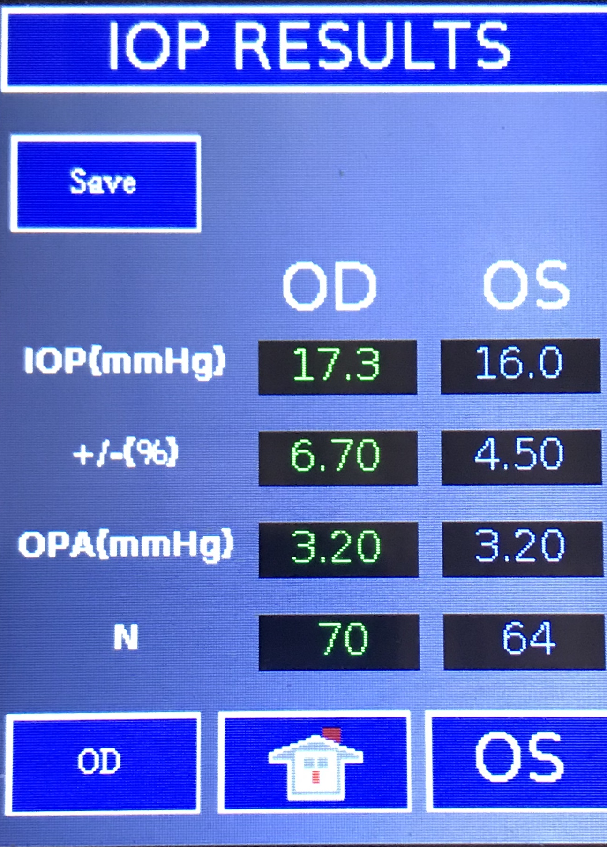
Intraocular Pressure
Optical Applanation Measurement
Compensates for Corneal Biomechanics
Multiple Serial IOP Measurements – N Value
Systolic and Diastolic IOP
Average IOP Displayed
IOP Variation with Cardiac Cycle - OPA
Precision Displayed

Slide 4
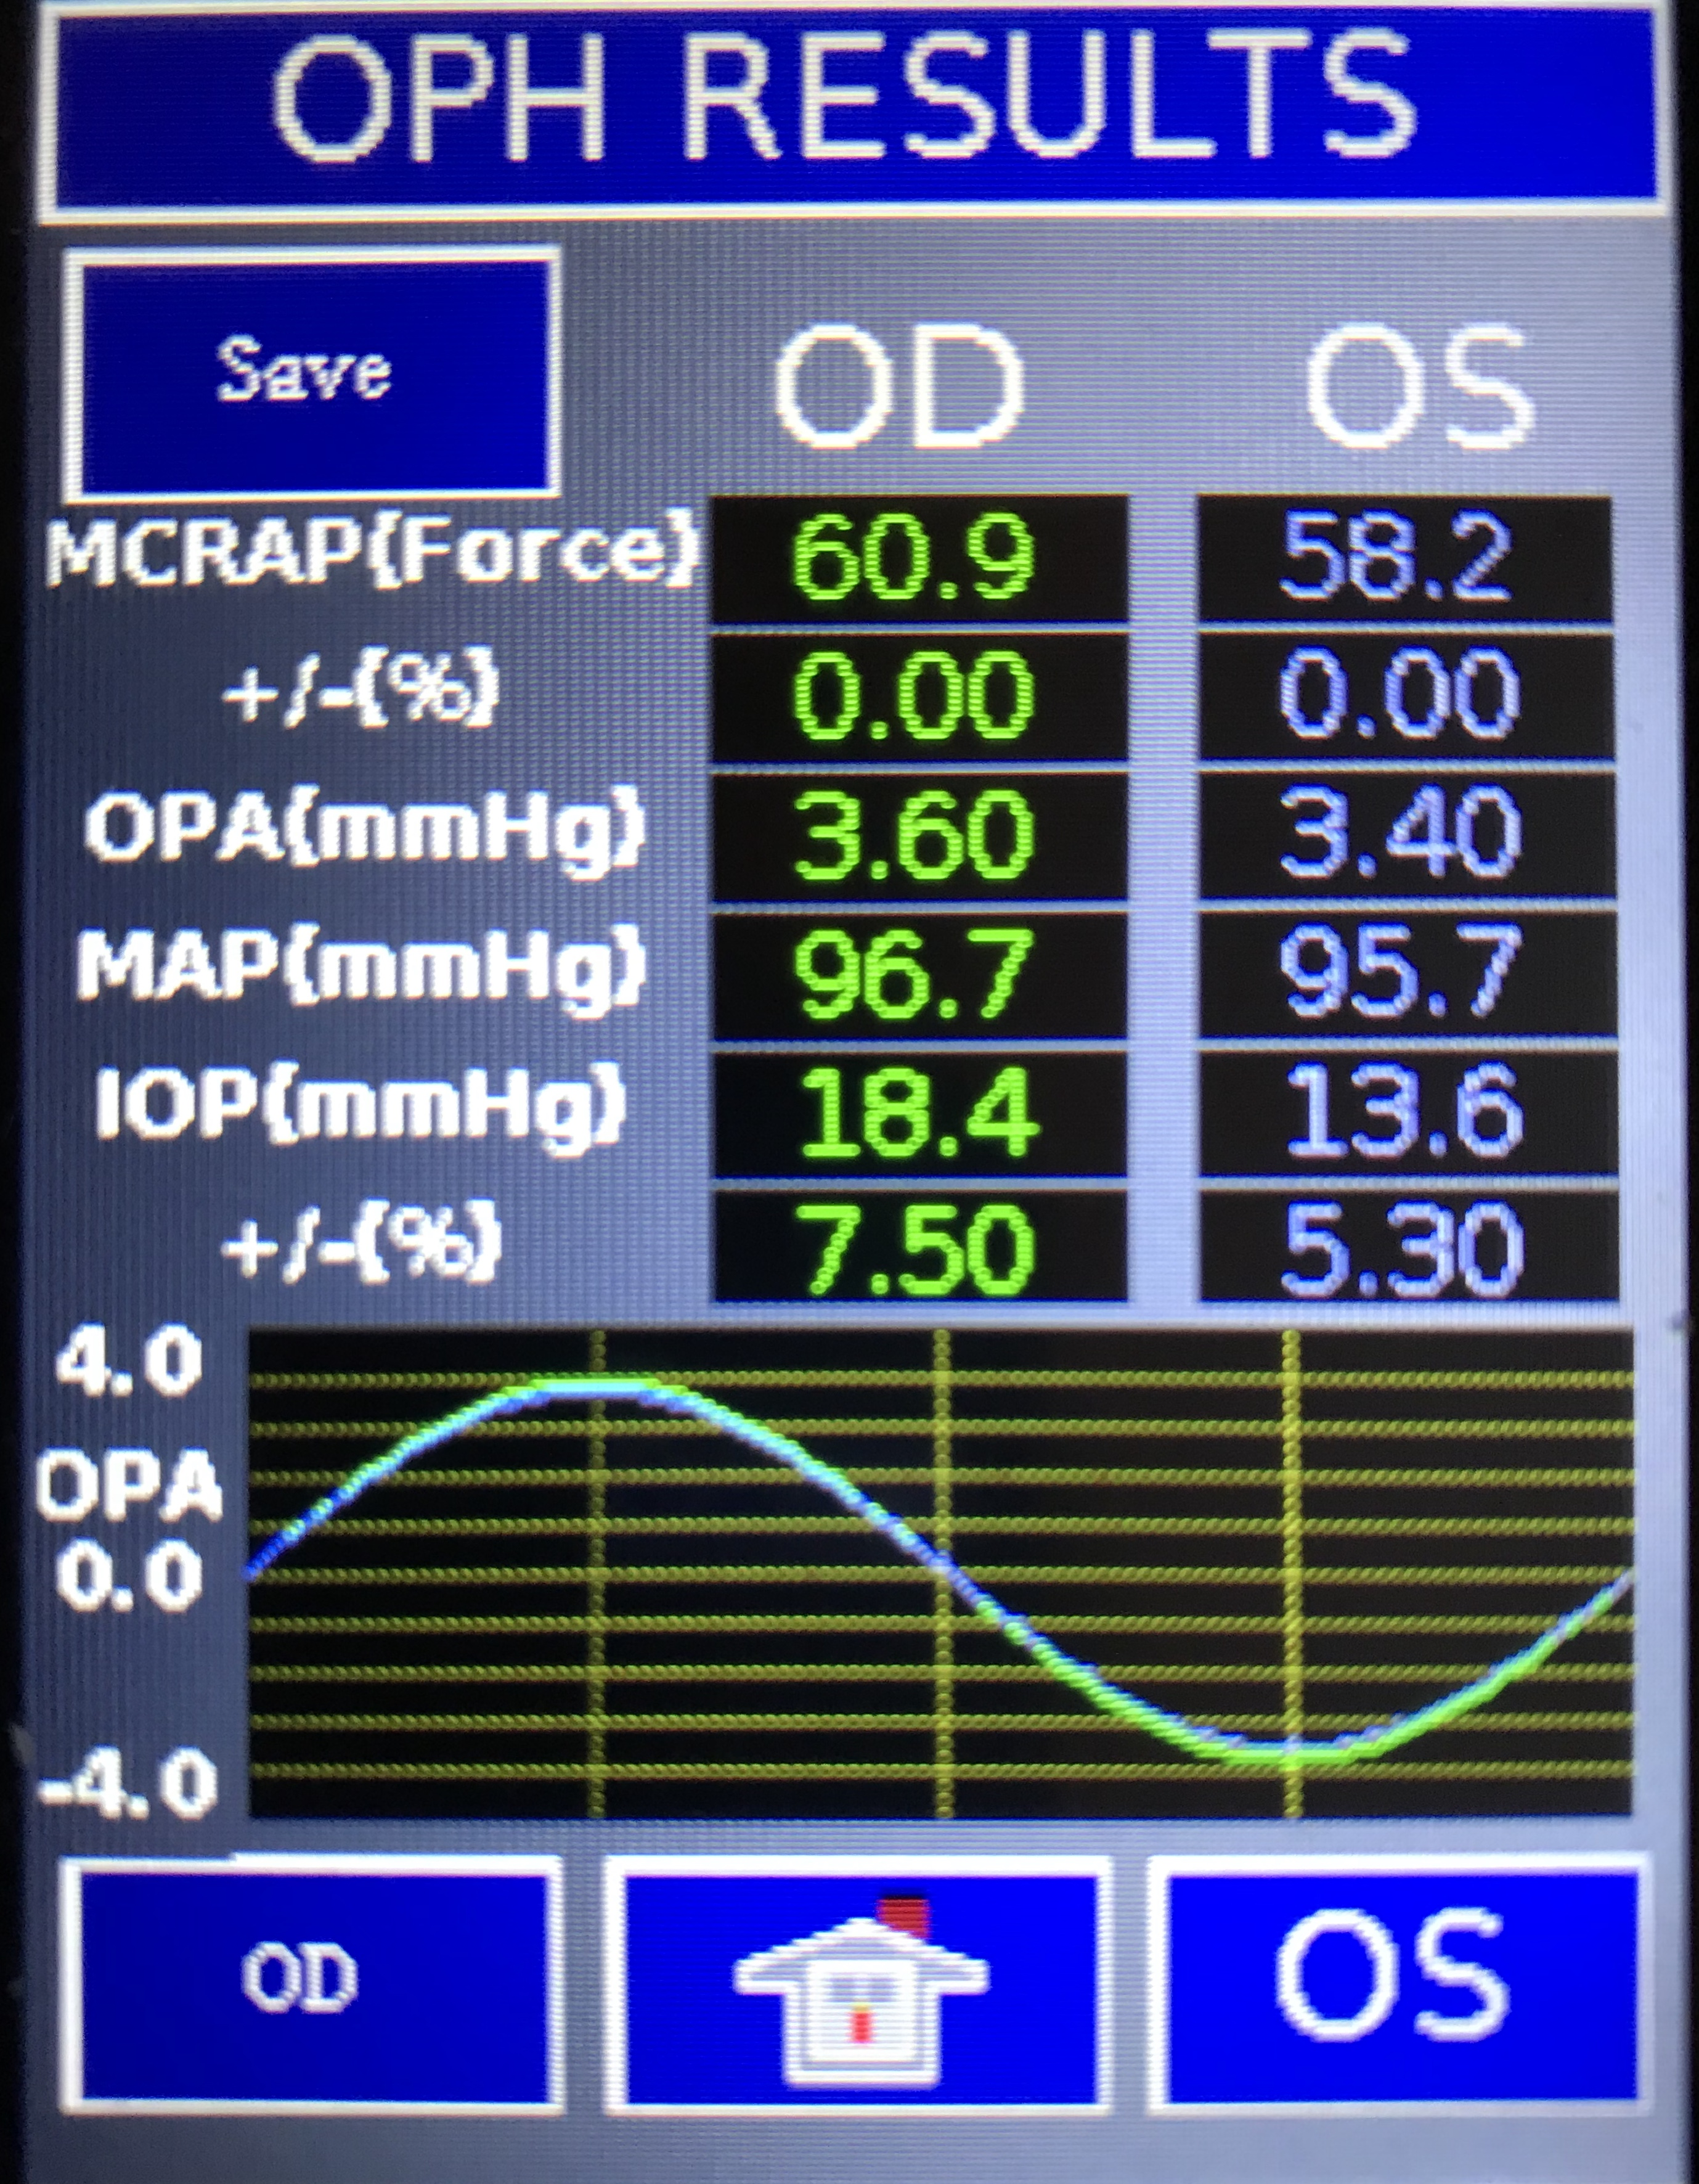
OPHTHALMODYNAMOMETRY
Mean Central Artery Pressure (MCRAP) measurement.
Data Captured During Multiple Cardiac Cycles.
Mean Arterial BP Displayed.
MCRAP – IOP = True Ocular Perfusion Pressure (OPP).
Reduced OPP is a risk factor for glaucoma progression.
Abnormal OPH - Increased Risk of Stroke.

Slide 5
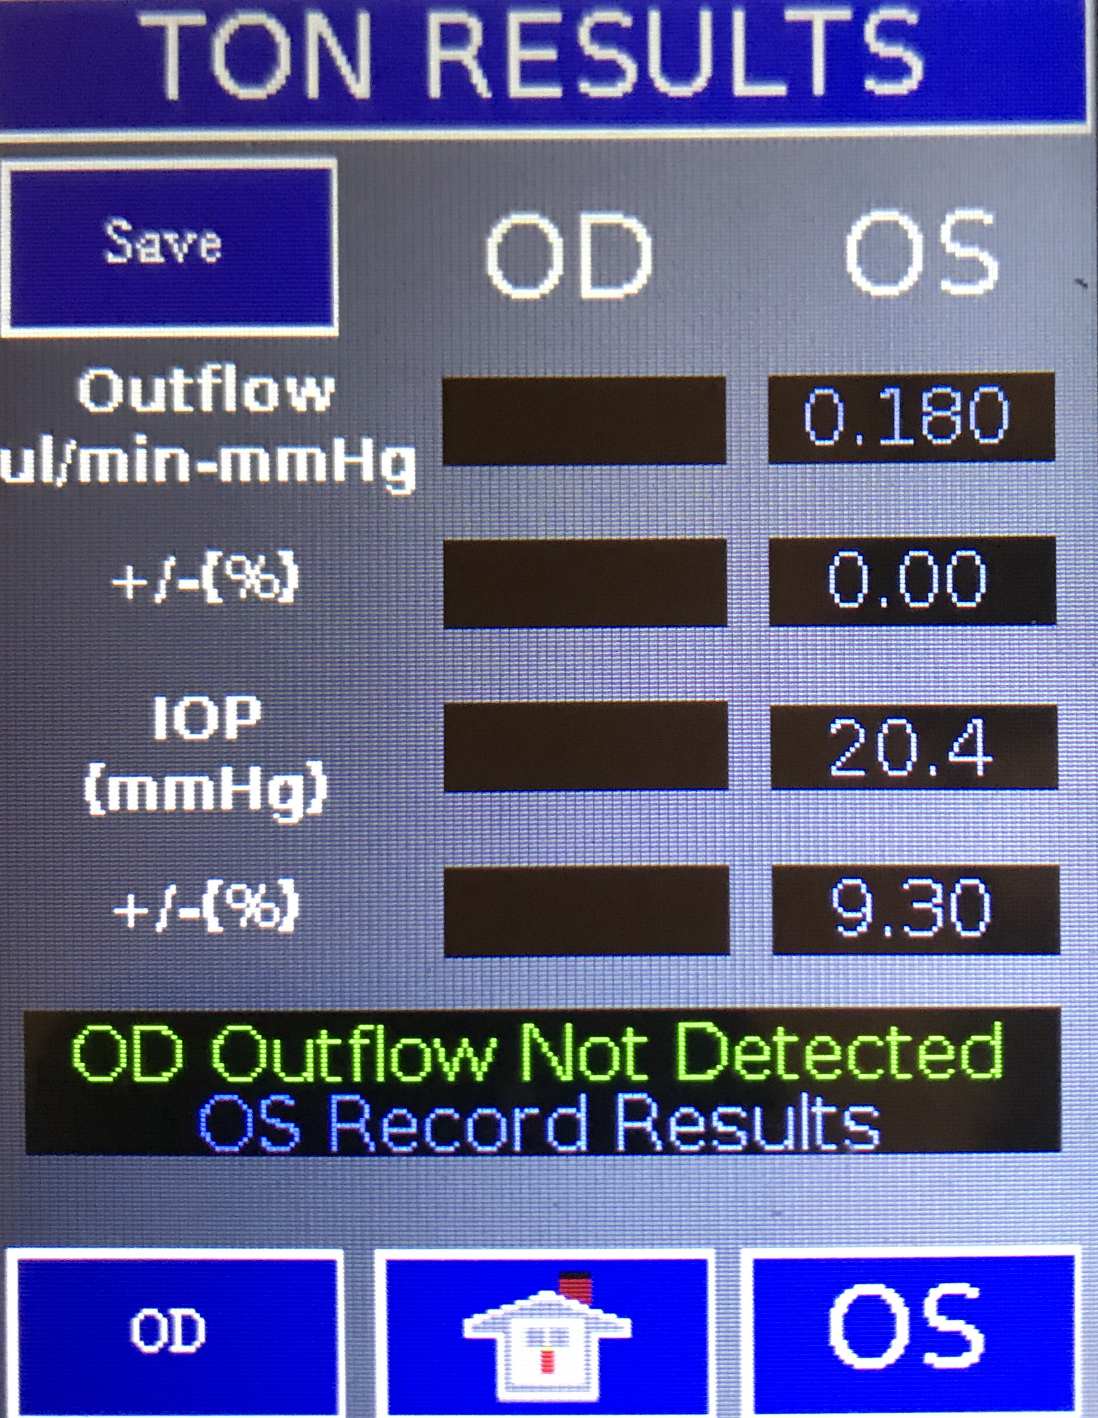
TONOGRAPHY
Optical Aqueous Humor Outflow Measurement.
Aqueous Outflow Decreased in Glaucoma.
Decreased Outflow = Increased TM Resistance.
Decreased Outflow = Increased IOP Fluctuation.
Document Therapeutic Efficacy of Outflow Interventions.
Document Need for Additional Intervention.
Glaucoma risk assessment.

Slide 6
Clinical comparison of the FAT1 and THE GAT
Protocol: FDA PMA single site blinded randomized clinical study. IOP, pachymetry and keratometry recorded. Two-hundred nine eyes enrolled.
Results:
No relationship between corneal thickness, curvature and FAT1 readings ( p=0.06, 0.04).
Linear regression relationship between FAT1 and GAT IOP readings, r squared value 0.925.
Bland Altmann Analysis, mean paired difference of diastolic IOP, FAT1 – GAT 0.7 mmHg.
Bias testing; Distribution and Randomness Test, T-Test and Wilcoxon Rank Sum Test. No bias found for measurement sequence, operator, intra—visit or inter-visit measurements.
Conclusion;
FAT1 readings not effected by corneal thickness or curvature.
No significant difference between FAT1 and GAT1 diastolic IOP readings.
FAT1 measurement results are independent of operator, visit sequence or testing sequence.

Slide 7
FAT1 Clinical TONOGRAPHY sTUDY
Protocol: FDA PMA Single Site Blinded Randomized Prospective Study. Sixty-one eyes with glaucoma and thirty eyes without glaucoma enrolled. One hundred eighty-two IOP and Outflow Facility measurements recorded.
Results:
Glaucoma Eyes: Average Pattern Defect: 3.67 +/- 4.1 db. Average Mean Defect – 3.00 +/- 3.6 db.
IOP range 12.9 to 42 mmHg.
Average Outflow Facility in Glaucoma Group: 0.09 +/- 0.05 ul/minute.
Average Outflow Facility in Normal Group: 0.31 +/- 0.12 ul/minute.
Outflow Facility difference between the Glaucoma Group and the Normal Group was statistically significant, p < 0.0001.
Impaired Outflow Facility correlated with glaucoma severity, < 0.09 ul/minute in advanced glaucoma eyes.
Bias analysis: No bias effect for operator (p=0.99), intra-visit (p=0.99) or inter-visit testing (p=0.64).
Conclusion:
FAT1 Tonographic Outflow Facility was significantly different in glaucomatous eyes versus normal eyes.
Eyes with advanced glaucoma had the lowest outflow facility.
FAT1 Tonographic measurements confirm that glaucomatous eyes have impaired outflow facility.
Measuring Outflow Facility is critical in the effective management of glaucoma.

Slide 8
Summary
FAT1 is the first artificially intelligent combination device.
Measures Serial IOP, Mean Central Retinal Artery Pressure (Ophthalmodynamometry), and Aqueous Outflow (Tonography).
Measures Diastolic and Systolic IOP.
Compensates for corneal biomechanics.
Fixed use disposable prism blocks infection.
FDA PMA blinded prospective clinical studies confirm FAT1 measurement accuracy and precision.
FDA PMA FAT1 clinical studies confirm impaired outflow in glaucomatous eyes.

